Slide 1
MRM Update and
Business Model
MISA Ontario
June 5-8, 2011

Slide 2
Municipal Reference Model
What is the MRM: MRM Refresher
MRMv2 Project Update: Where are we now?
MRMv2 Business Model
Quick Demo/Screen Shots – Teaser for Wednesday Session (10:30 am)

Slide 3
What is the MRM
MRM Refresher

Slide 4
MRM v2 Vision
In response to renewed interest:
A tool (product, service) to help municipalities describe their business from a client-centric perspective: in terms of the programs and services they provide
…in a standard way
…using precise definitions and concepts accepted and adopted by all governments in Canada
…with tools and templates
…with user guides and training material
…with a repository where these descriptions can be saved
…repository pre-populated with a generic set of municipal services and service profiles
…allowing each municipality to load and customize their service descriptions and associated data and share with other users
…with tools that allow for the analysis and comparison
…and a collaboration space that allows ideas to be shared on how these tools are being used in participating municipalities

Slide 5
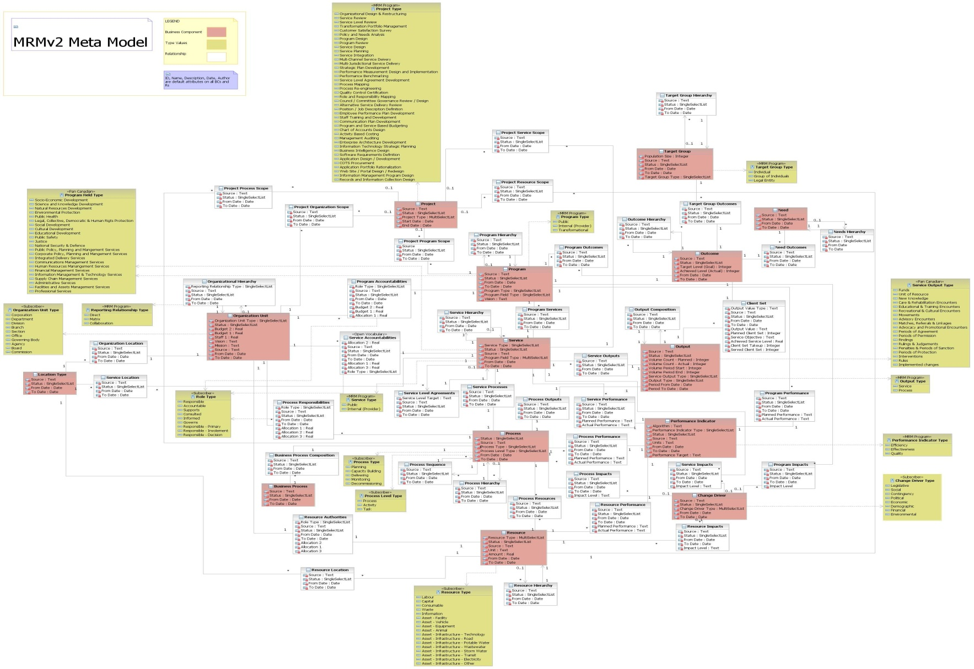
MRMv2 Meta-Model
CAUTION: DO NOT TRY TO READ THIS SLIDE!
Notes:
Caution reading this slide of the “meta model” where “pink” entities are core entities, “white entities: are intersection entities, and “dijon mustard yellow” entities are type tables.

Slide 6
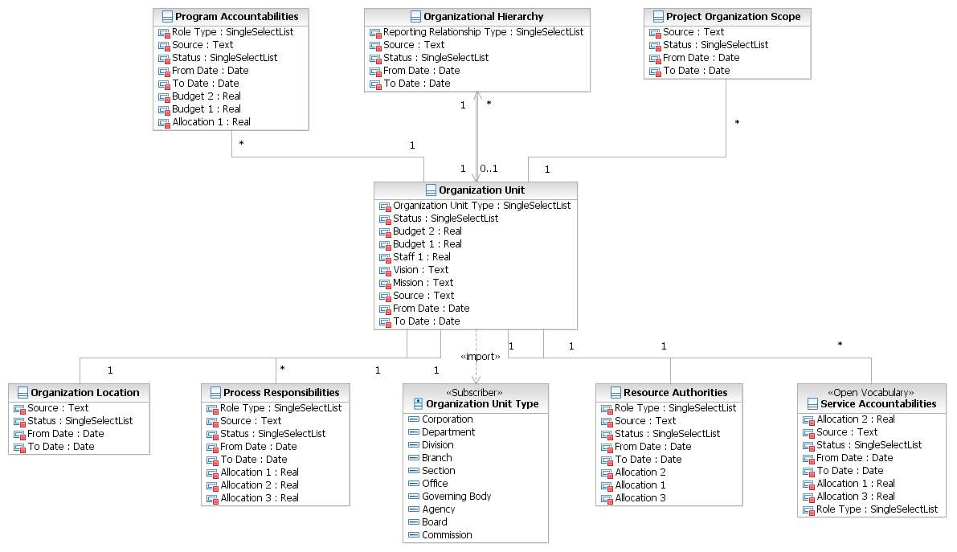
MRMv2 Meta-Model Extract
Notes:
A diagram illustrating the “meta model” element associated with an Organization Unit and how it is related to “first level” entities.

Slide 7
MRMv2 Selected Standard Vocabulary
Strategic Terms:
  Vision
  Mission
  Core Values
Program Terms:
  Program Goal
  Program Need
  Program Outcome
  Program Target Group
Service Terms:
  Service Output
  Service Output Type
  Process
  Activity
  Task
  Client
  Service Value (to client)
Performance Metric Terms:
  Efficiency
  Effectiveness
  Quality
Role Terms:
  Governance
  Accountability
  Responsibility
  Authority
  Activity
Enterprise Architecture Terms:
  Mandate
  Events
  Cycles
  Jurisdiction

Slide 8
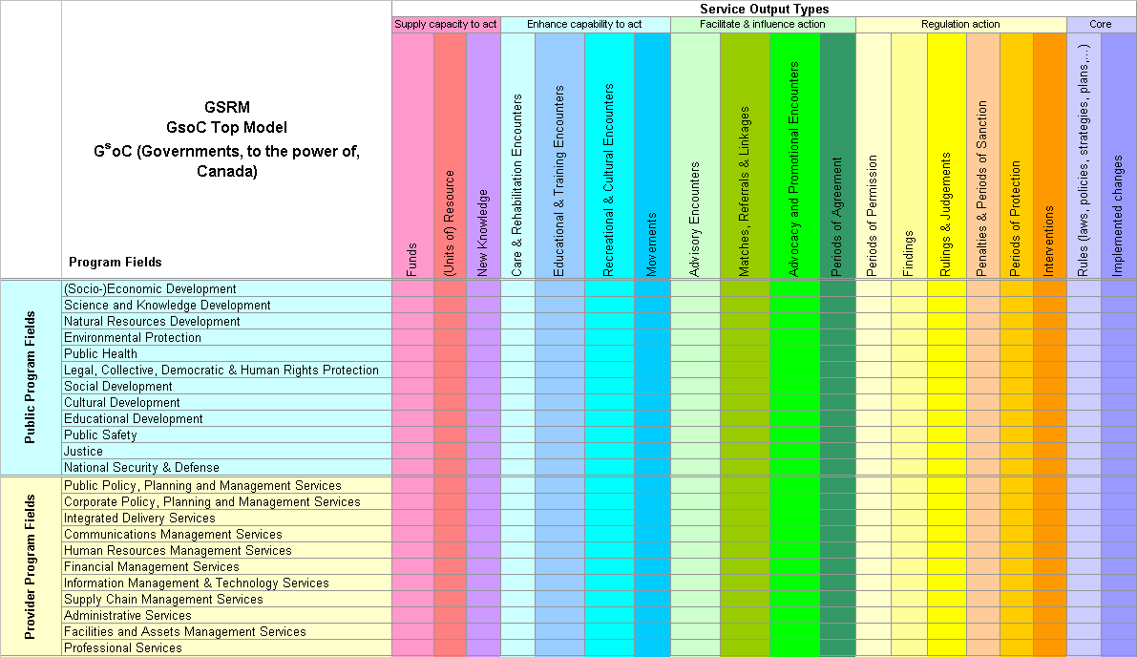
MRMv2 Standard Value Lists
Source: Government of Canada Strategic Reference Model (GSRM) specification

Slide 9
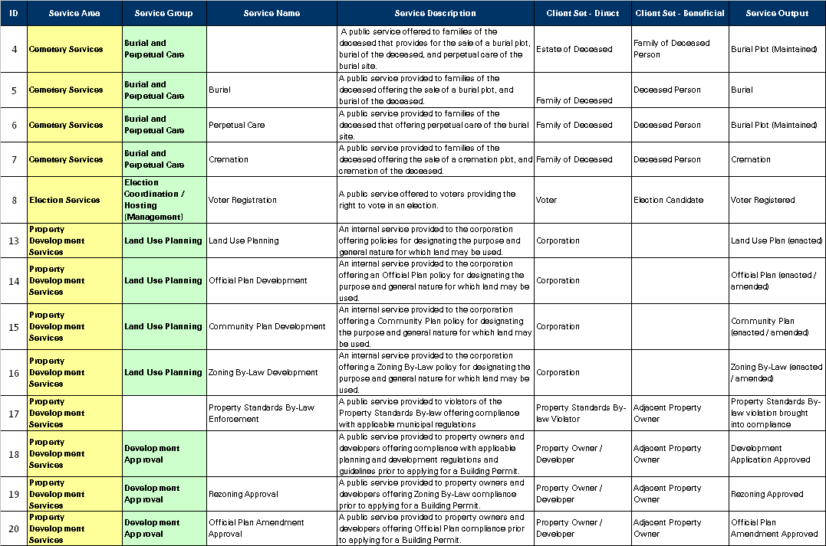
MRMv2 Reference Model
of Municipal Programs and Services
About 100 high-level municipal services; Over 1,000 detail-level municipal services
Notes:
Sample Reference Model Services – Currently Under Development!

Slide 10
MRMv2 Standard Set of Programs & Service Profiles
Emergency Care and Preventative Care Service
Service Type | Public
Accountable Unit | EMS
Purpose Statement | Provide excellent emergency and preventative care services to the people of Toronto through activities such as providing pre hospital emergency care, community medicine and inter facility patient transport services
Customer | EMS Patient Family / Relatives
Products / Types | Primary /Advanced Critical | Stand By special event Stand By Emergency
Output | EMS Emergency Care, Preventative Care, Facility Transport
Delivery Method | Upon Request
Service Level | 24/7/365
Efficiency | $ / Emergency Care & Preventative Care by type
Value Statement | improved health reduction in mortality | reduced pain reduced health care cost
Effectiveness | Response Time to Incident ( Road Response Time + Process Time) Correct Resource response time according to Call priority (90% of the time) Percentage of Unit Hour Utilization | Cost of Unit Hour Production Mean Hospital Wait Time (Total Wait Time / # of Hospital Visit ) # of Public Access Defibrillators
Service Objective | Improve the response time to life threatening calls (delta & echo) from 70% to 90% within 8:59 minutes and stated targets for alpha, bravo and charlie category type calls. Reduce the in hospital time from 60 minutes to 45 minutes by 2008
Community Impact | Health Care Public Safety

Slide 11
MRMv2 Components
MRM Reference Model
(i.e. Public Safety Program, Fire Rescue Service, etc.)
Customized “My Municipality’s” Model
MRM Meta-Model
(i.e. Shell Program, Shell Service, etc.)
Customized Municipality C Model
Best Practice Model
(i.e. AWWA Potable Water Supply Service, etc.)
Customized Municipality B Model
Customized Municipality A Model

Slide 12
MRMv2 Project Update
Where are we now?

Slide 13
Where are we now?
MRMv2 Content Governance
MRM Standards Board
  Approve content of the MRM meta-model and Reference Model, as recommended by Working Groups
Meta-Model Working Group (MMWG)
  Recommend content of the meta-model (entities, definitions, attributes, relationships, value lists, including how they are implemented in System Architect
  Membership: Skip Lumley, Alan Mitchell, Roy Wiseman, Jim Amsden (IBM)
Reference Model Working Group (RMWG)
  Review and recommend > 1,000 Services / Service Profiles (integrating work from five participating municipalities: Edmonton, Fredericton, Peel, Toronto, Windsor
  Membership: Skip Lumley, Alan Mitchell, “Experts” from these five municipalities

Slide 14
Where are we now: MRMv2 Content
Modeling Principles, Definitions and Rules
  Version 1.0 Complete (March 2011)
  Author: Skip Lumley
MRM Quick Reference Guide
  Version 1.0 Complete (March 2011)
  Author: Alan Mitchell
Authoritative Reference Model (ARM)
  Under Development (Approximately 50% Complete, Target completion: end of June 2011)
  > 100 high-level services (e.g. business licensing)
  > 1,000 detail services (e.g. body rub parlour licensing
  For each Service: Name, Description, Output, Output Type, Client, Need, Value, Sub-Service, Program, GSRM Policy Field
  “Expert Panel”, applying modeling rules (above) and integrating existing Service Inventories from Edmonton, Fredericton, Peel, Toronto and Windsor

Slide 15
Modeling Principles and Rules - Extract
Service
Definition: A Service is a commitment to deliver Outputs that contribute to Outcomes
Naming:
The name of a Service should be defined as a combination of “modifier” (optional), “noun” (mandatory) and “gerund” (mandatory). For example, a Service should be named ‘Solid Waste Collection’ rather than ‘Solid Waste’. Modifiers are not always required, e.g. Business Licensing. The Service's name should make sense with and without the word “Service” following the name when required by context.
Valid Instances:
The Service’s existence should not depend essentially on the existence of another Service; if that is the case, the activity is typically a feature or configuration of that other Service. (Independence Rule)
  Example: traffic control and signage are not Services because they depend on the existence of the ‘Roads Service’. Traffic control and signage are features that increase the quality and effectiveness of the ‘Roads Service’ because they enable more, safer, and more convenient trips.
Delivery of the Output defined for the Service should fully satisfy the Need(s) addressed by the Service, commensurate with the intentions of the government and the legitimate expectations of the client. (Closure Rule)
  Example: fixing a pothole does not by itself satisfy a driver’s expectation of a trip, nor the government’s intent to enable it, and is therefore not a Service but a Process forming part of the ‘Roads Service’.
  Example: processing an application form for a building permit does not by itself satisfy a client’s need for permission to build, nor the government’s intent to grant compliant requests, and is therefore not a Service but a Process forming part of the ‘Building Permit Service’.
The Service’s Output cannot be mandatory for all members of its Target Group; otherwise the Service is an Enterprise Management Process or Program Management Process. (Non-Mandatory Rule)
  Example: developing a strategic plan is not a service if each department must participate in it. If, on the other hand, an Organization Unit offers assistance with the preparation of individual strategic plans, e.g. departmental or program plans, then an Enabling Service is formed.
Attributes: Standard Attributes

Slide 16
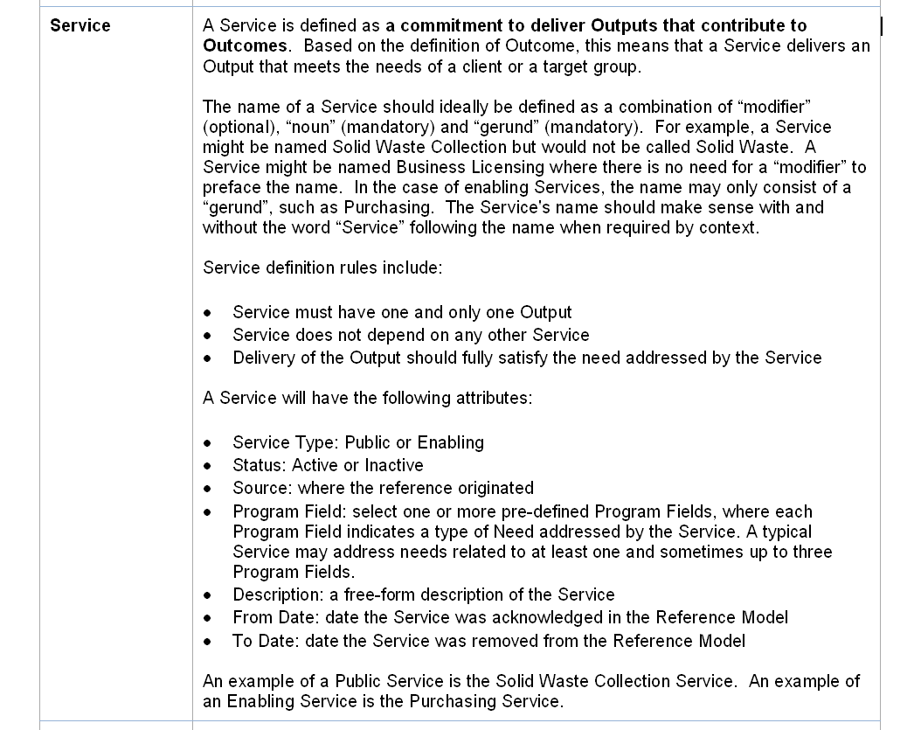
Quick Reference Guide - Extract

Slide 17
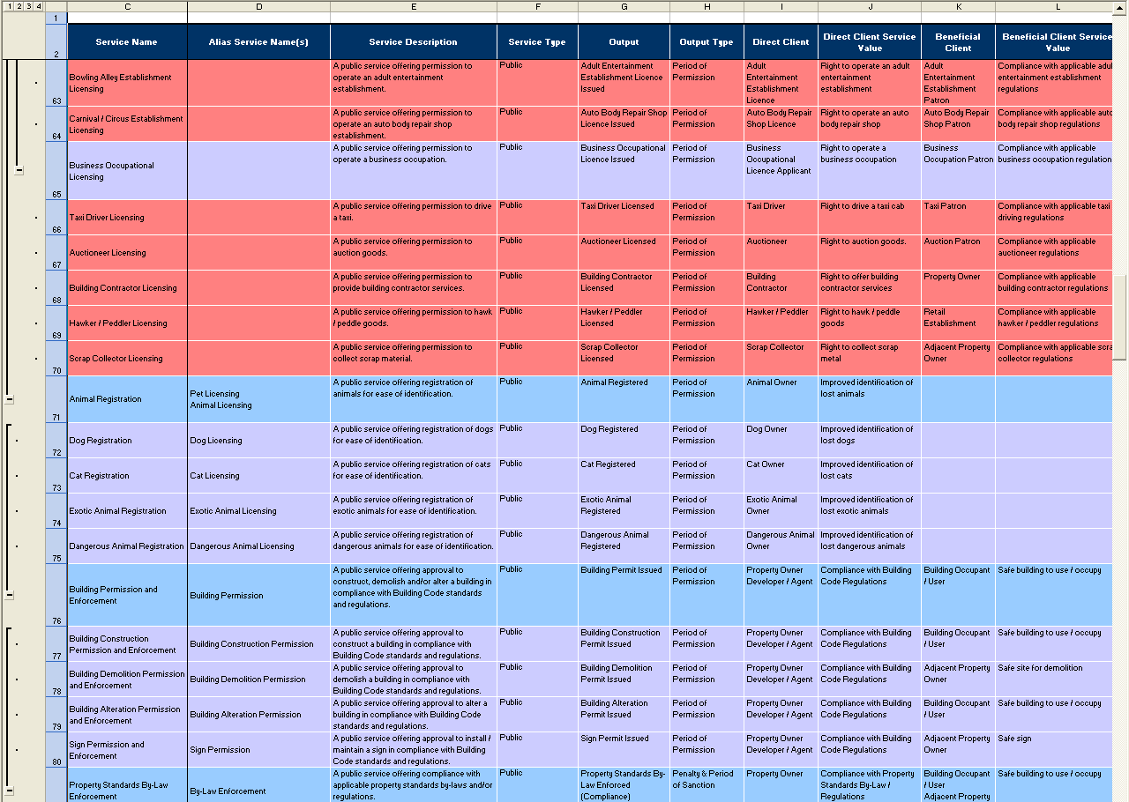
Authoritative Reference Model - Extract

Slide 18
Where are we now: MRM Software
  Availability delayed: Initially planned for Summer 2010
  Following MISA Ontario 2010 Conference, IBM undertook “architectural review”
  Recommended new toolset based on Rational System Architect.
  System Architect installed at e-Solutions hosting site
  MRM Meta-Model and Draft Reference Model loaded into System Architect by IBM (Jim Amsden)
  Pilot (Region of Peel) confirmed capabilities and usability of System Architect
    Conclusion: System Architect provides an excellent platform for the MRM
  Continue to refine configuration of MRM in System Architect to enhance usability and provide more value (e.g. implementation of the meta-model in SA, data input screens, reporting, diagrams)
  Add 3-5 users (existing subscribers) during Summer of 2011, to gain further insight and allow further tuning before broader release in the fall

Slide 19
MRMv2 Business Model:
Short Term

Slide 20
Business Model Working Group
Current business model addresses the short term viability and sustainability of the MRMv2 products and services.
Further work on the long term vision and growth strategy needs to be completed after “testing the market” with the initial release of the product.

Slide 21
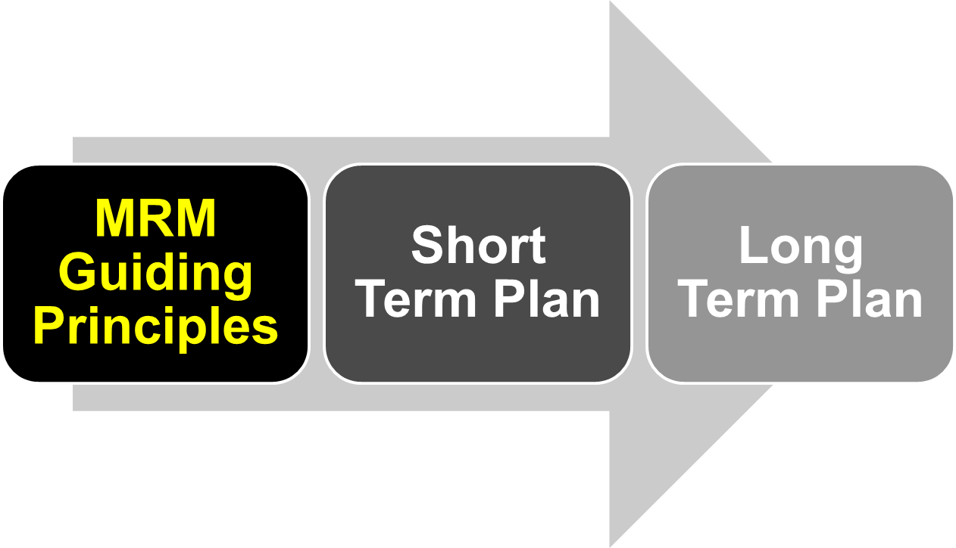
MRM Business Model

Slide 22
MRM Guiding Principles
Enable MRM to become a widely adopted and endorsed de facto standard for municipal services modeling.
Ownership remains with MISA, which includes intellectual property rights, administration, development, maintenance, support, promotion.
Non-for-profit. Available to municipalities (MISA Members) at minimal cost.

Slide 23
MRM Guiding Principles continued
Support the initial participants to be successful in leading the pack and demonstrating the value of adopting the standard.
Acknowledge both the pioneers who contributed significantly and subsequent contributors.
Recognize financial limitations and challenges of different municipalities.

Slide 24
MRM Guiding Principles continued
Services provided are the same regardless of the size of the municipality.
Short Term Business Model (12 – 18 months) is required to address the immediate needs in launching the services; Long Term Business Model is required to address future needs for sustaining and furthering the services.
Anticipate and encourage broader private sector participation, not immediately but in the future (Long Term Business Model).

Slide 25
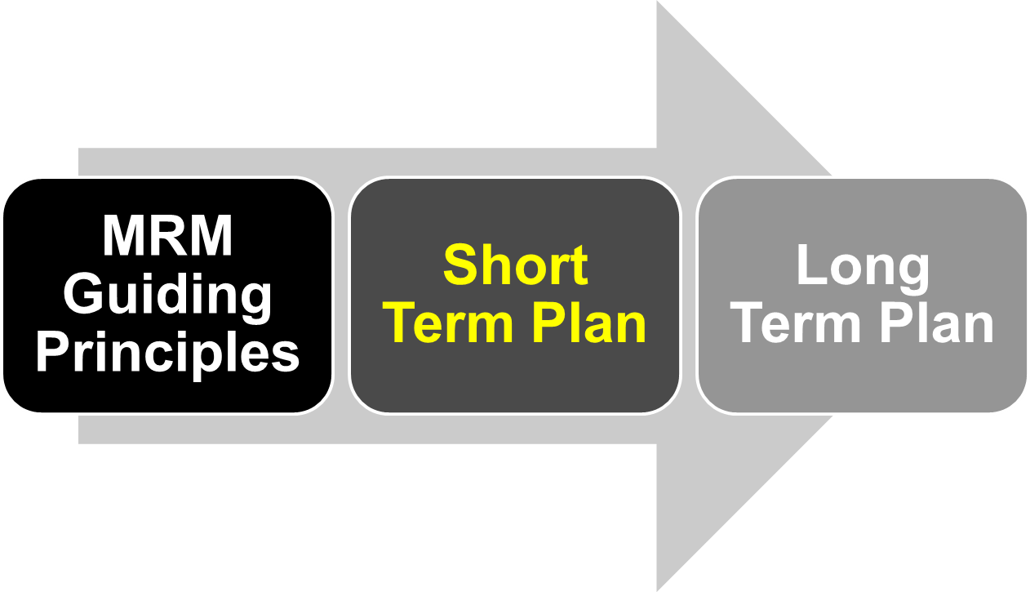
MRM Business Model

Slide 26
Short Term Plan
In return for their initial investment, based on a fee schedule outlined below, municipal subscribers will receive for a period of two years a core set of services which include:
  Access to MRM website for use of tools (already developed);
  Content: meta-model, reference model, use cases, as implemented with the IBM software (System Architect);
  User Guides and instructions on both the MRM principles and use of the software
  Initial training on use of the tools
  Further enhancements to both content and the implementation within the software, as may be developed over that time
  Collaboration with other subscribers (access to other municipalities’ published models)
Existing Subscribers: Edmonton, Fredericton, Halton R, London, Markham, Mississauga, Niagara R, Peel R, Richmond Hill, Saskatoon, Timmins, Toronto, Waterloo C, York R, Joint Councils

Slide 27
Short Term Plan: User Benefits Package
Publicly Available: MRM meta-model; Quick Reference Guide
Full Subscribers
  Modeling Principles Handbook
  Authoritative Reference Model
  Access Quickr Collaboration Site (unlimited) and System Architect (10 hours/month for each $5,000 contribution)
  Access Published “My Municipality” Models on Quickr Site and in System Architect
  MRM Introductory Training (half-day) and System Architect Training (one day)
    One attendee per $5,000 contribution
    Discounted rate for additional attendees
  Participate in MRM Standards Board
  Participate in MRM System Architect User Group (identify and prioritize enhancements)
Content Only Subscribers
  Modeling Principles Handbook
  Authoritative Reference Model
  Access Quickr Collaboration Site (unlimited)
  Access published “My Municipality” Models on Quickr site
  MRM Introductory Training (half-day)
    One attendee per $2,500 contribution
    Discounted rate for additional attendees
  Participate in MRM Standards Board
NOTE:
The continued availability of the Content Only subscription will be reviewed as part of the longer term plan

Slide 28
Proposed Subscriber Fees
Population | Content Only | Content Plus Software
> 500,000 | $12,500 | $25,000
300,000 – 500,000 | $10,000 | $20,000
100,000 – 300,000 | $7,500 | $15,000
50,000 – 100,000 | $5,000 | $10,000
< 50,000 | $2,500 | $5,000

Slide 29
Short Term Plan continued
Sustainment and continued development of the service, after the first two years, may require an annual subscription fee (assumed to be a fraction of the initial investment) to cover operating costs and to maintain access to the services
  The need and amount of an annual subscription fee will be confirmed as part of the Longer Term Business Plan.
  Options which can avoid or reduce the need for an annual fee will be explored.

Slide 30
Short Term Plan continued
Ongoing support:
  First level support provided by the website vendor (eSolutions)
  Second level support (subject matter expert) provided by volunteer resources
    Using collaboration forums where questions can be posed and volunteers will commit to monitor and provide answers

Slide 31
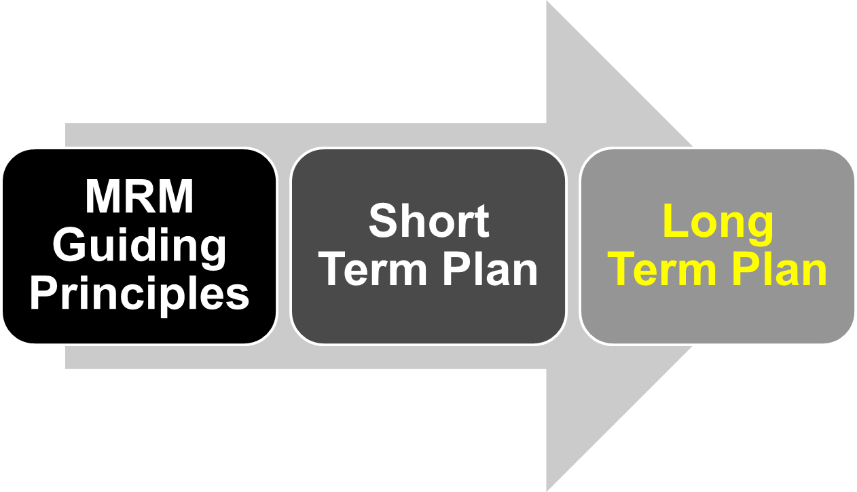
MRM Business Model

Slide 32
Long Term Plan: Visioning Session
June-July 2011, Open to interested participants (public and private sector)
  Review Principles
  Review Business Model
    Services to be offered and to whom (classes of subscribers/users)
    Modes and options for providing the services (how can we do it?)
    Pricing
  Options to reduce operating costs
    Hosting costs, software licensing costs, support costs, training costs, etc.
  Options to generate revenue
    Subscribers, consultants, trainers, software developers, government grants, use by other governments (domestic and international), etc.

Slide 33

Long Term Plan: Still Lots To Do
MRMv2
2+ years of work
is just the tip of the
iceberg
“We have only just
begun”

Slide 34
System Architect Demo
Screen Shots

Slide 35
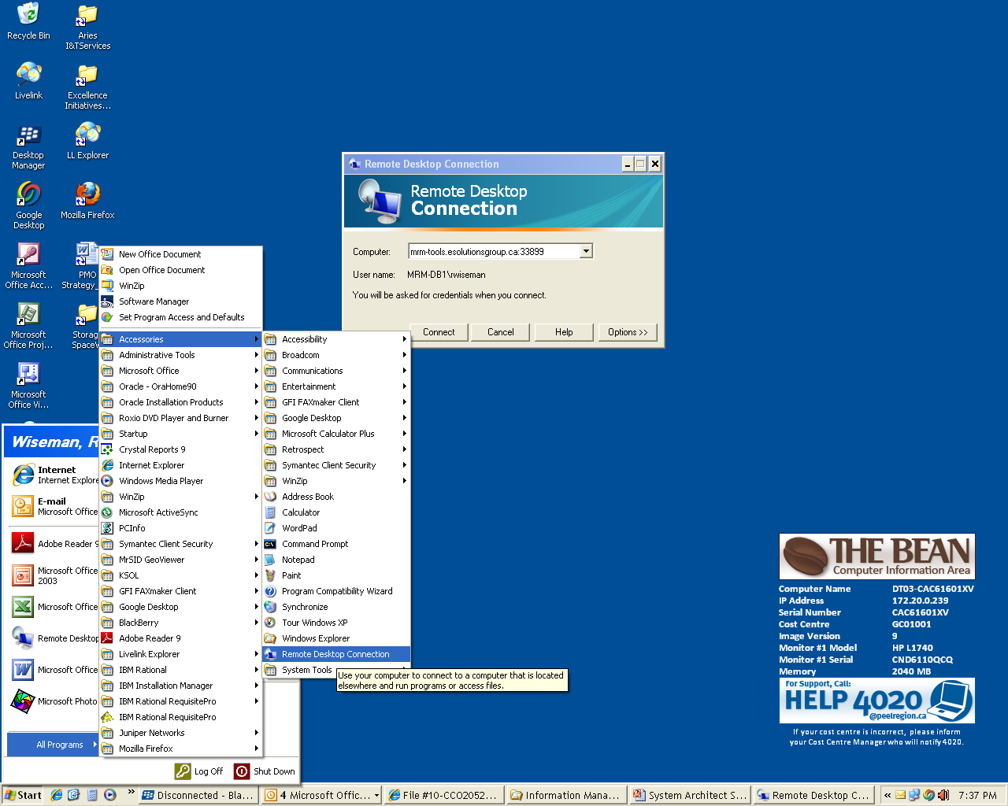

Slide 36
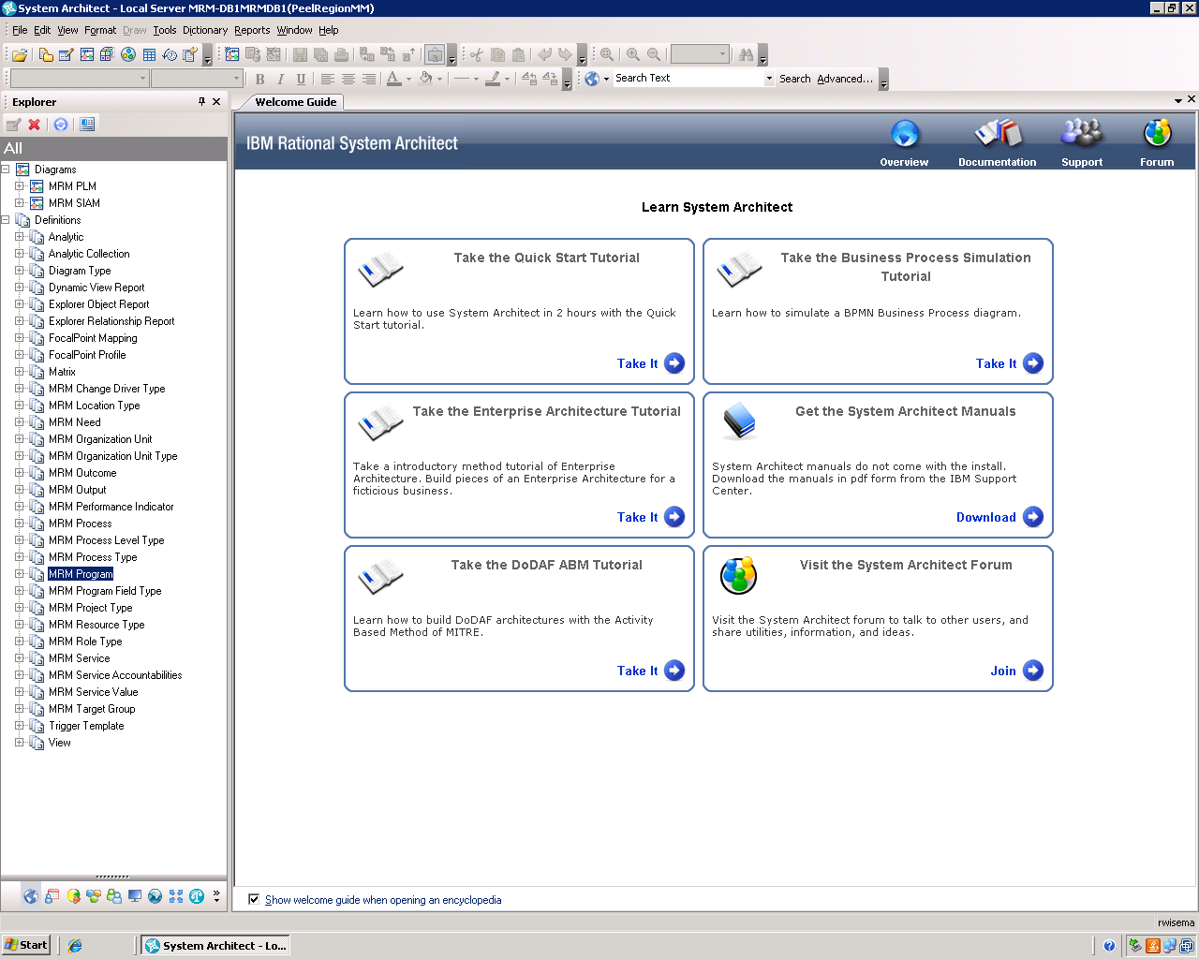

Slide 37
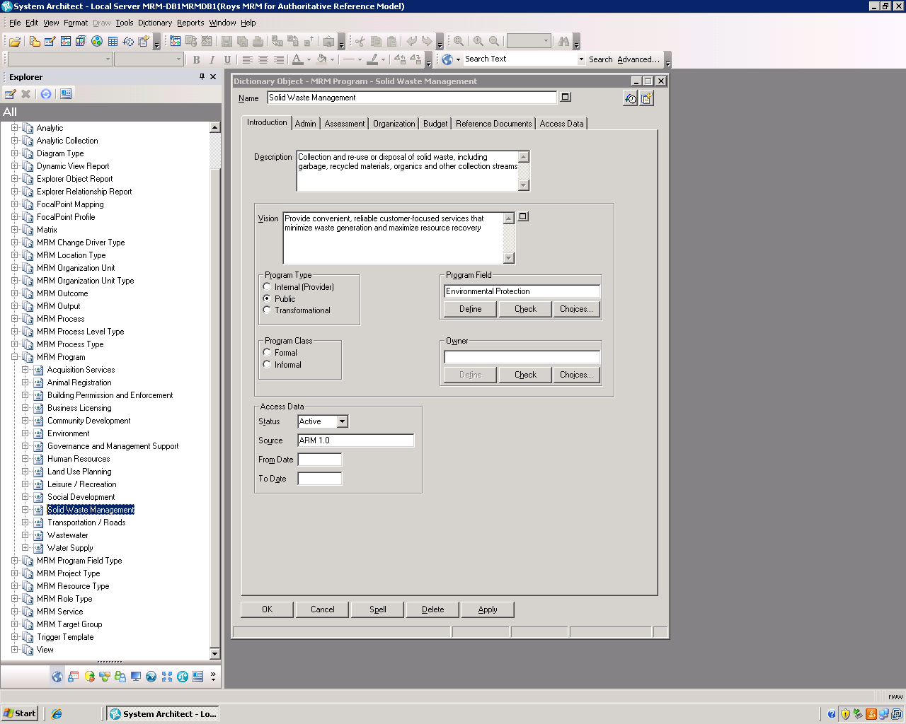

Slide 38
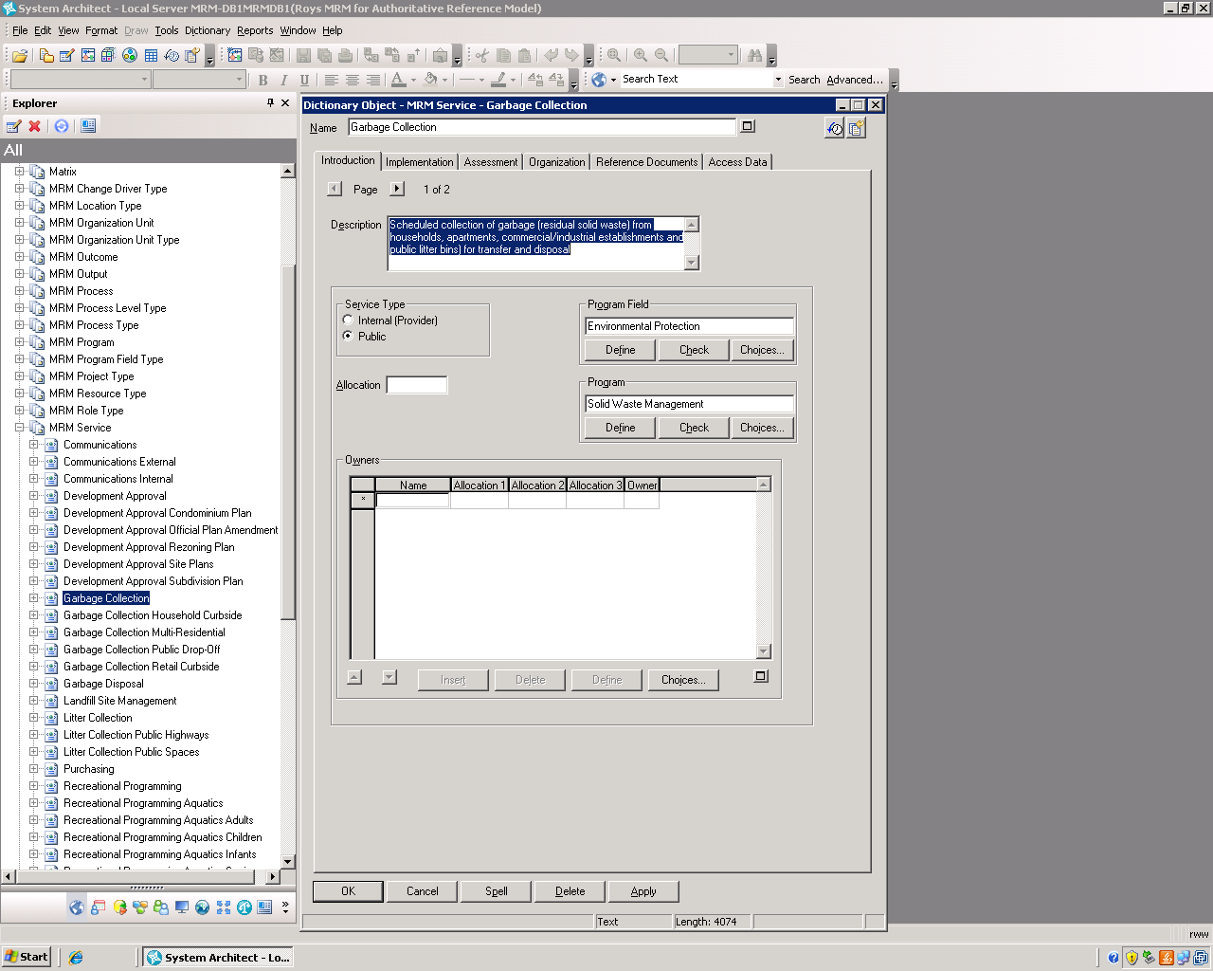

Slide 39
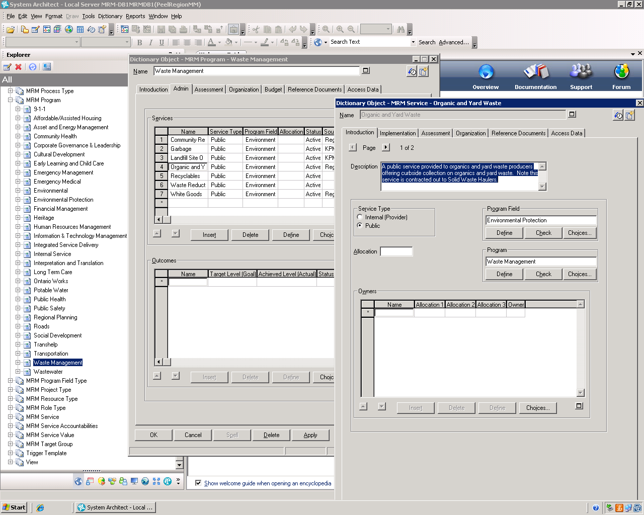

Slide 40
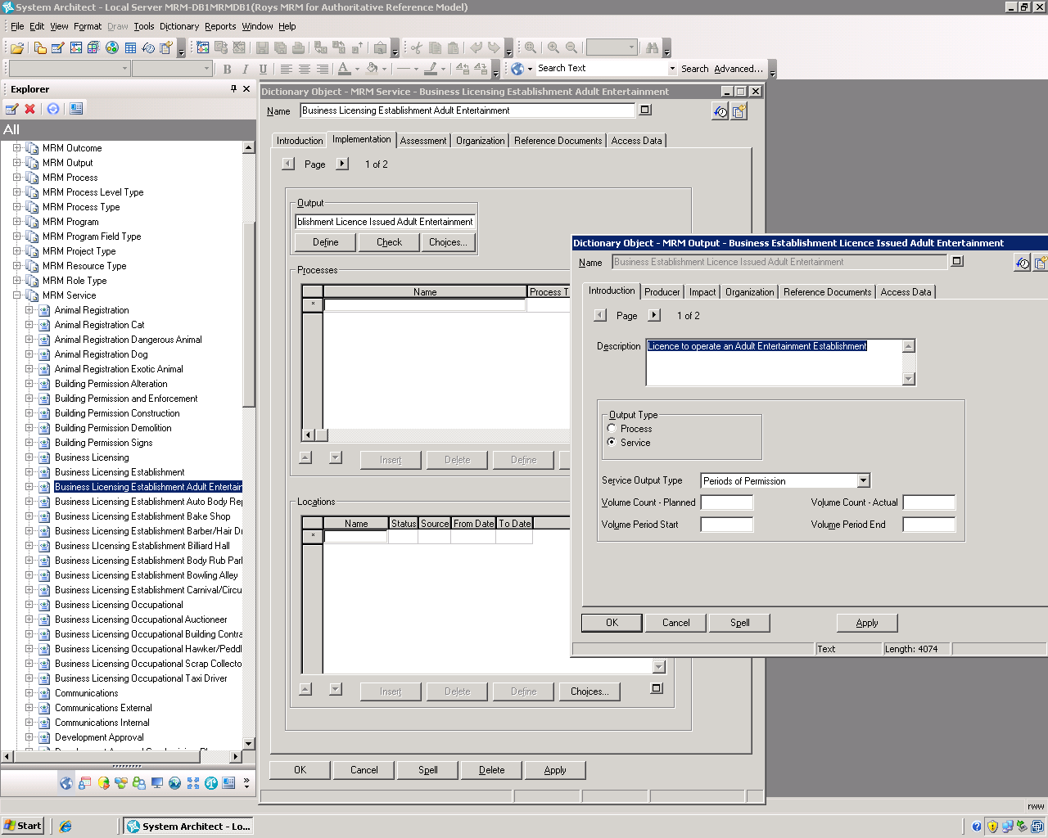

Slide 41
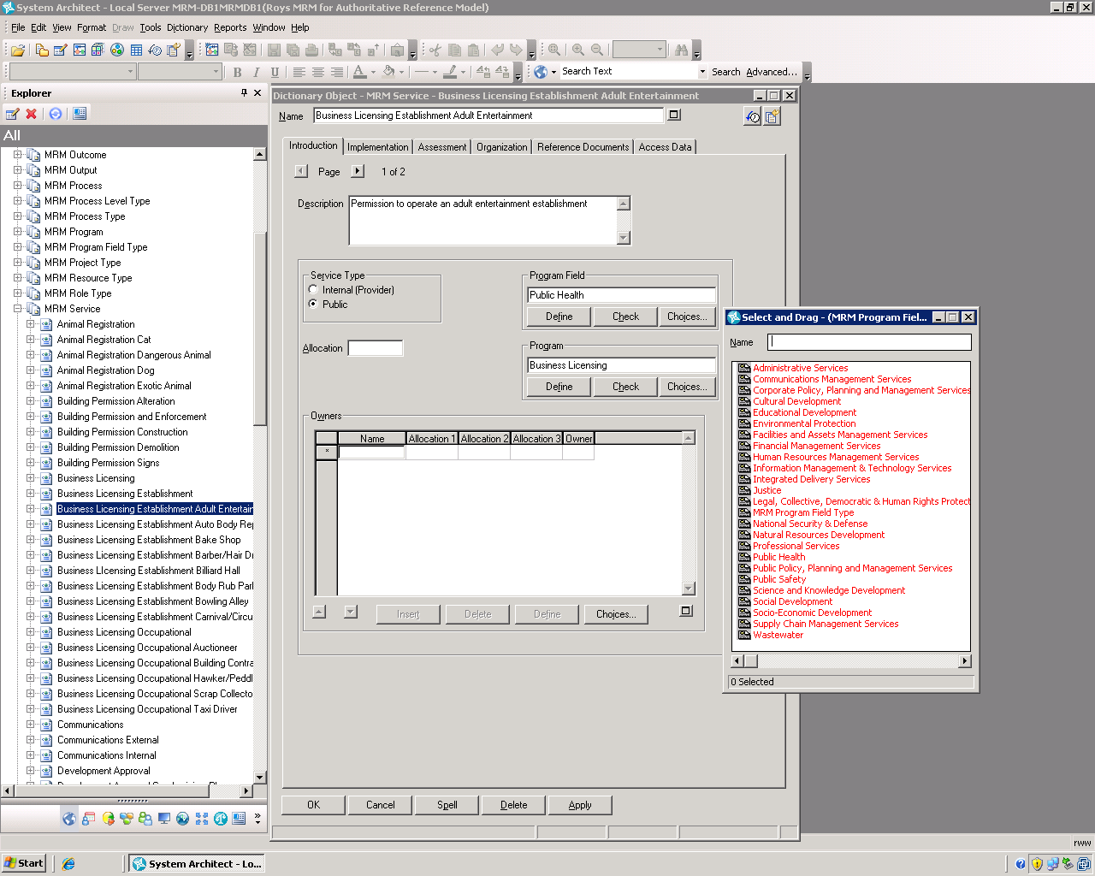

Slide 42
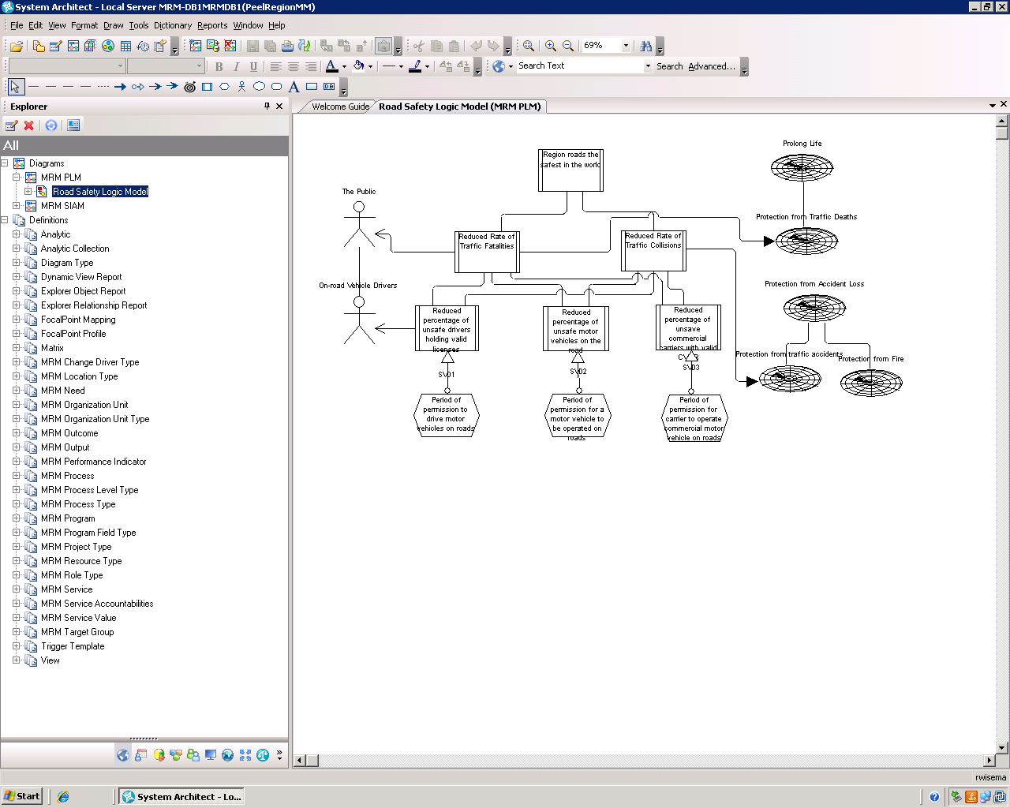

Slide 43

Questions/Comments

